Slide 1
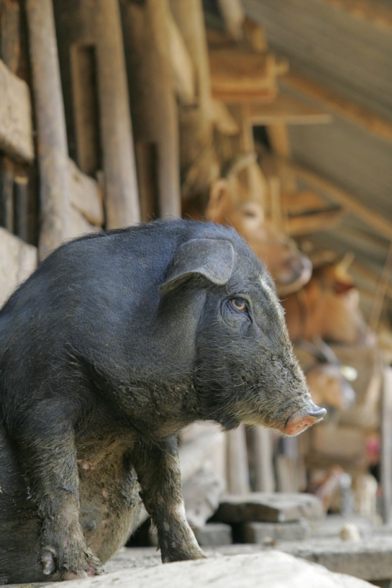
Global African Swine Fever
Research Alliance
Cyril G. Gay, DVM, PhD
Senior National Program Leader
Animal Production and Protection
Agricultural Research Service
Fighting African Swine Fever Together

Slide 2
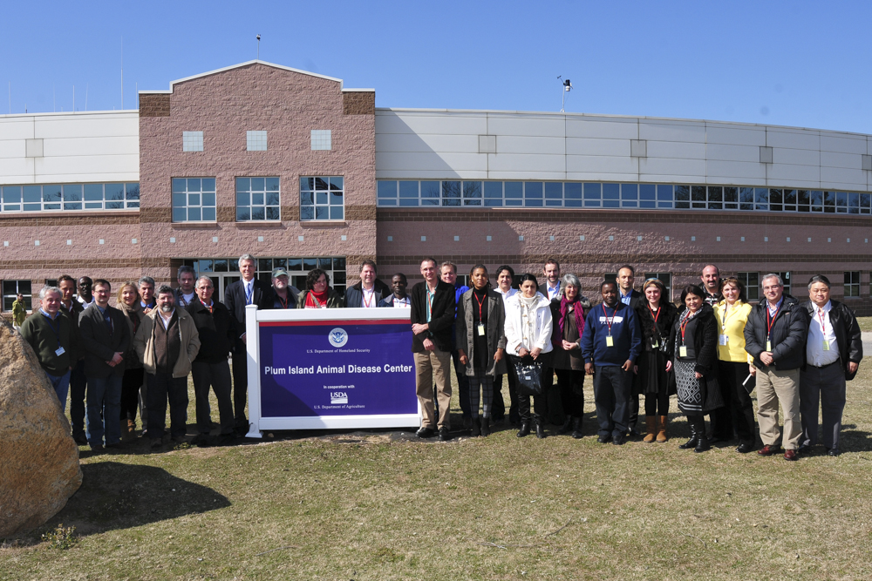
Launch of GARA
April 4, 2013, Plum Island Animal Disease Center

Slide 3
Launch of GARA
GARA Vision and Mission
Strategic Goals
Membership
Structure
Communication
Research Collaborations
Fighting African Swine Fever Together

Slide 4
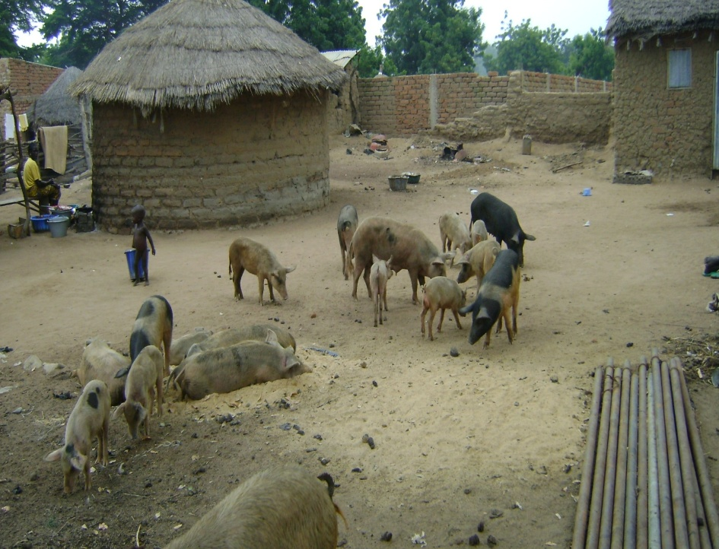
Vision of GARA
A coordinated global research alliance enabling the progressive control and eradication of ASF
Fighting African Swine Fever Together

Slide 5
Mission of GARA
To establish and sustain global research partnerships that will generate scientific knowledge and tools to contribute to the successful prevention, control and where feasible, eradication of African Swine Fever
Fighting African Swine Fever Together

Slide 6
The research pipeline: why research is important
Basic
Research
Translational
Research
Applied
Research
Technology
Transfer
Countermeasures
Diagnostics
DISCOVERY
ED
FD
LAUNCH
Vaccines
Scientific
Information
Pathogenesis
Transmission
Epidemiology
Modeling
Biosecurity

Slide 7
Future Strategic GARA Collaborations?
Uganda
Tanzania
South Africa
Republic of Georgia
Armenia
Ukraine
Russia
Portugal
Spain
China
United States
United Kingdom
Australia
Vietnam
South Korea
China
Fighting African Swine Fever Together

Slide 8
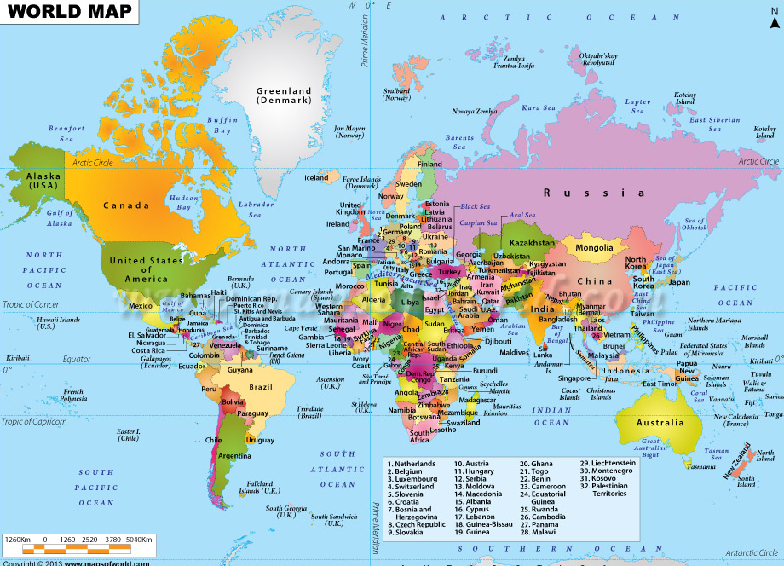
GARA: A network of Research Collaborations
Fighting African Swine Fever Together

Slide 9
Strategic Goals of GARA
Goal 1. Identify research opportunities and facilitate collaborations within the Alliance
Goal 2. Conduct strategic and multi-disciplinary research to better understand ASF
Goal 3. Determine social and economic drivers and impact of ASF
Goal 4. Develop novel and improved tools to support the prevention and control of ASF
Goal 5. Determine the impact of ASF prevention and control tools
Goal 6. Serve as a communication and technology sharing gateway for the global ASF research community and stakeholders
Fighting African Swine Fever Together

Slide 10
Membership
Any organization interested in enabling the GARA vision and mission is encouraged to join the alliance. There are three membership options:
1. GARA Partner. ASF research organization that has signed the GARA Memorandum of Understanding
2. GARA Collaborator. Organization that collaborates on a research project with a GARA member
3. GARA Stakeholder. Organization that benefits, shares , or supports the GARA mission
Fighting African Swine Fever Together

Slide 11
GARA – Structure
GARA Partners
30 partners have signed the GARA MoU
6 additional collaborators
Stakeholders
STAR-IDAZ, AU-IBAR, Merial, Harrisvaccines, Aptimmune Biologics, Zoetis Animal Health
Fighting African Swine Fever Together

Slide 12
GARA Communication: GARA Brochure and Web Site
Brochure
Pictures, logos, vision, mission, strategic objectives (in preparation)
Website
Established and maintained by ARS
http://www.ars.usda.gov/GARA/
Links to all member institutes web sites
Lists of collaborations and scientists’
Meeting reports
Fighting African Swine Fever Together

Slide 13
Achievements and planned Activities 2013-2014 Action Items
ASF Gap Analysis and Countermeasures Workshop, Plum Island, April 3-4, 2013
Training course on ASF, RVF, PPR and LSD prevention, recognition and control, ARC-OVI 27-30 May 2013
ASF gap analysis report to be published December 2014
Organization of the GARA Executive Committee, January 2014
GARA scientific meeting, Southern Africa, planned for April 2014

Slide 14
GARA Executive Committee
President (2013-2015)
Livio Health, ARC-Onderstepoort Veterinary Institute, South Africa HeathL@arc.agric.za
President Elect (Vacant)
To be selected in 2015
Chief Executive
Covadonga Alonso, Department of Biotecnologia, INIA, Spain
calonso@inia.es
Science Director
Linda Dixon, Pirbright Institute, United Kingdom
linda.dixon@pirbright.ac.uk
Finance Director
Bob Rowland, Kansas State University, United States
browland@vet.k-state.edu
Executive secretary
Cyril Gay, USDA, Agriculture Research Service, United States
cyril.gay@ars.usda.gov

Slide 15
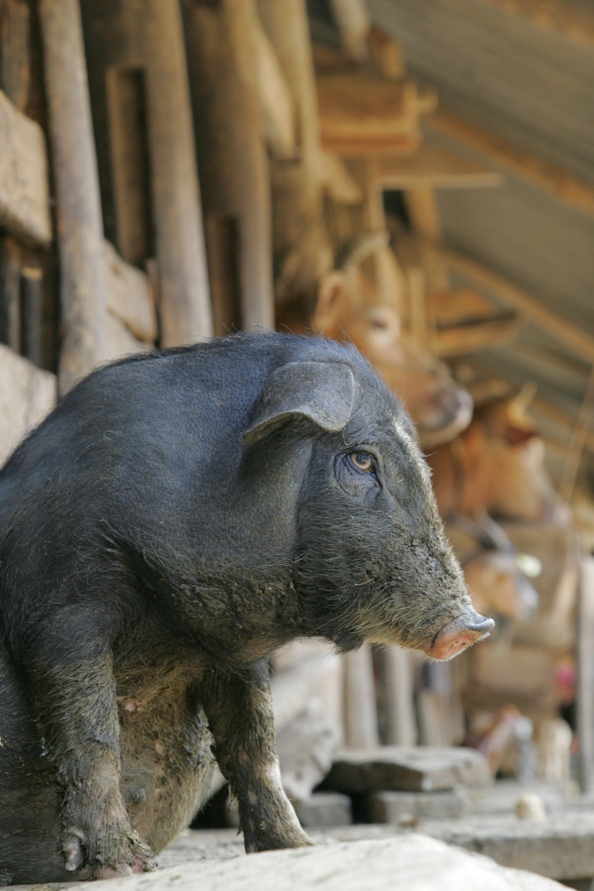
Questions/Comments/Discussion
Fighting African Swine Fever Together

